Slide 1
IS RESEARCH SEMINAR · 214.4001 · FINAL PRESENTATION
Not all differences matter.
So who decides which ones do?
Governed human judgment in agentic-AI variability exploration — a structured exploratory literature review
RESEARCH QUESTION
How can human judgment be captured, governed, and used to support agentic-AI-driven variability exploration in guideline operationalization scenarios, enabling reliable human–AI co-reasoning?
Ali Hamed
M.Sc. Information Systems · University of Haifa
Supervisors: Prof. Iris Reinhartz-Berger · Prof. Arnon Sturm
Doctoral working draft · research-question wording provisional, not supervisor-approved · no empirical or medical claim.
Notes:
Open with the boundary, not a boast. This is a controlled literature review and a research
agenda - not an empirical result.
Then the tension: Iris's own MODELS paper is called "Not All Differences Matter" - the class
saw her present it in week 5. My question starts one step later. Once an agent has found a
difference, WHO decides whether it is a legitimate alternative or an error, and how does that
decision stop being thrown away? (~35 sec)

Slide 2
MOTIVATION · THE PROBLEM
An AI can find every difference — not which ones matter
The same structural deviation can be three different things, and only situated judgment separates them.
A
B
C
A legitimate alternative
A different representation can be valid under the same language semantics and domain meaning. Penalising it teaches the wrong lesson.
A genuine error
A misconception, omission, syntax violation or domain mistake that should be corrected.
A defective guideline
The reference itself may be incomplete, underspecified or mismatched to the case — the deviation is evidence against the norm.
“Human-in-the-loop” is not one problem. It is four design problems:
when to ask · what to capture · how to govern · when to reuse
Notes:
Ground the problem before any technology. The same difference can be a valid alternative, a
real error, or evidence that the guideline itself is wrong.
Then the reframing that drives the whole review: human oversight is not a slogan or an
approval button. It decomposes into four testable design problems. Those four become my
sub-questions. (~50 sec)

Slide 3
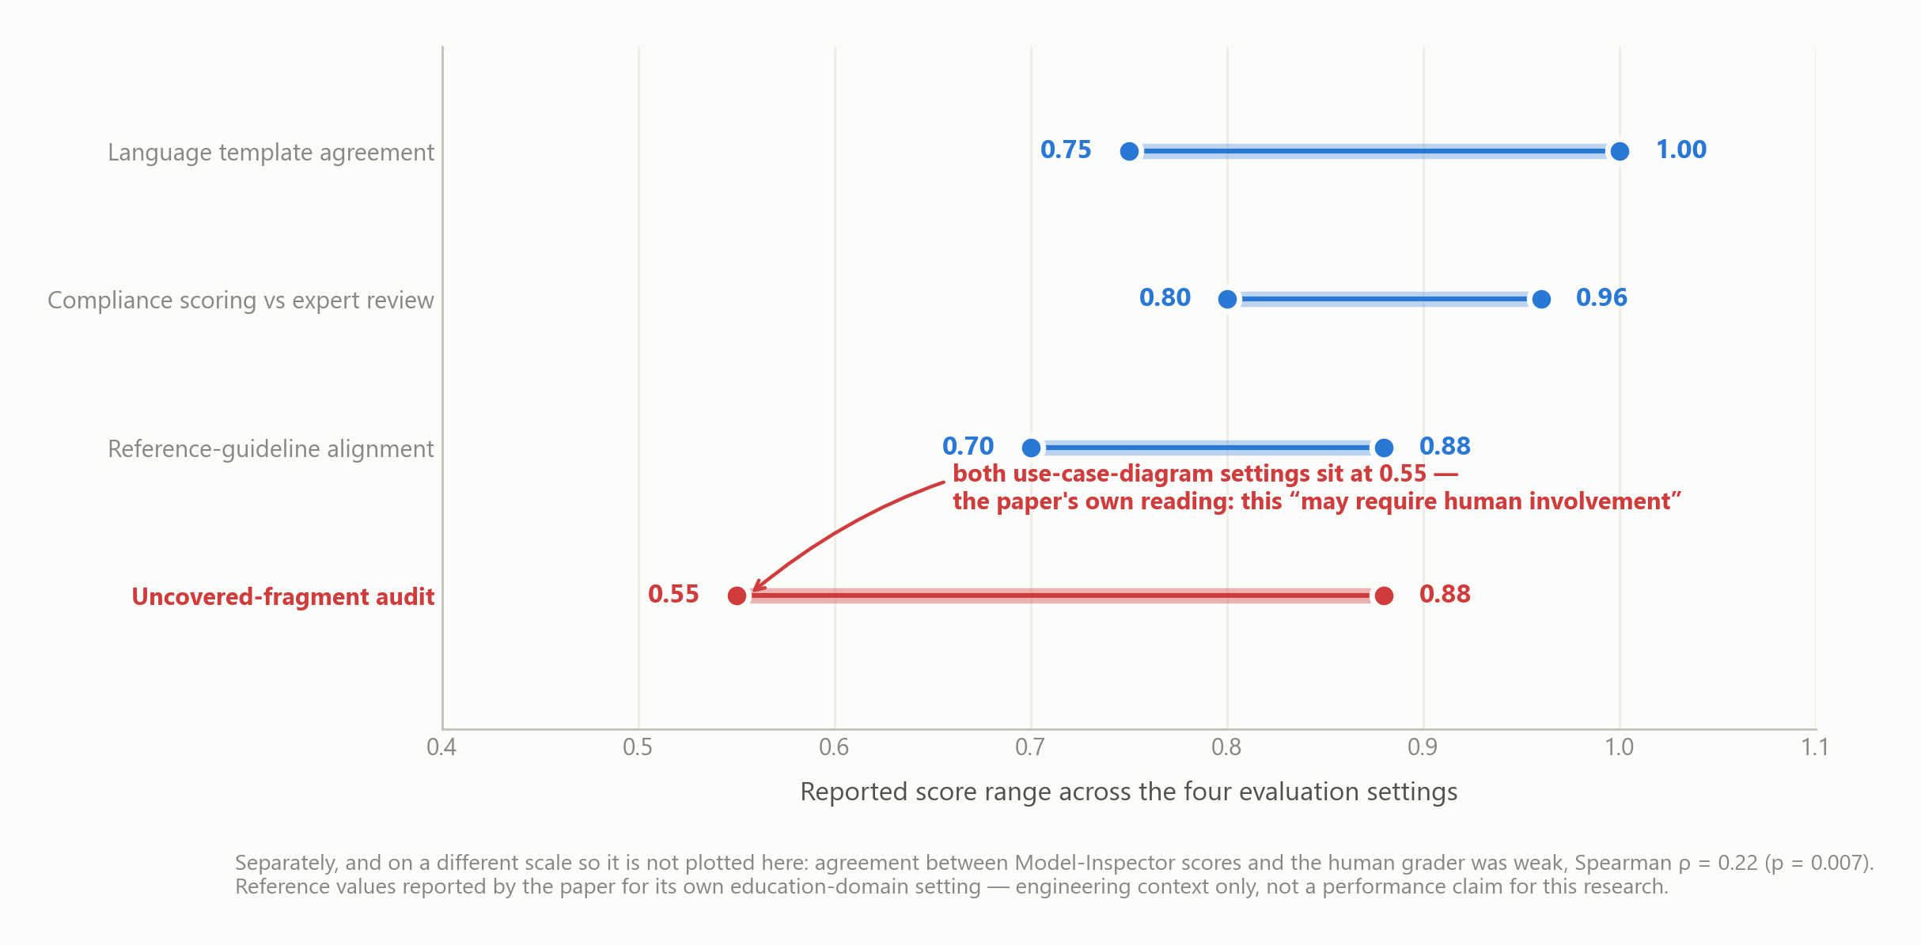
MOTIVATION · EVIDENCE FROM THE PROBLEM WORLD
The framework names its own need for a human
VEGO-AI assesses domain models with four coordinated LLM agents. It works — unevenly, and it says so.
ρ = 0.22
Reported correlation between Model-Inspector compliance scores and the human grader.
The paper's own future work:
“incorporating human-in-the-loop oversight at key pipeline stages (guideline validation, compliance review, and variability classification) would strengthen reliability”
The need for human judgment is not my assumption. It is the framework's own stated next step — and it names the three stages.
Figures as reported by the paper for its own education-domain evaluation (two domains, one institution, one LLM, two modelling languages) — reported findings, not independently reproduced here.
Notes:
This is the strongest motivation slide because almost none of it is mine.
The framework's own authors report that uncovered-fragment auditing sits at 0.55 in both
use-case settings, and that agreement with the human grader is weak. Then their future-work
section names exactly the three pipeline stages where oversight is needed - which is my SQ1,
in someone else's peer-reviewed paper.
Be precise: these are THEIR numbers, in THEIR setting, reported not reproduced. I claim
nothing about my own performance. (~55 sec)

Slide 4
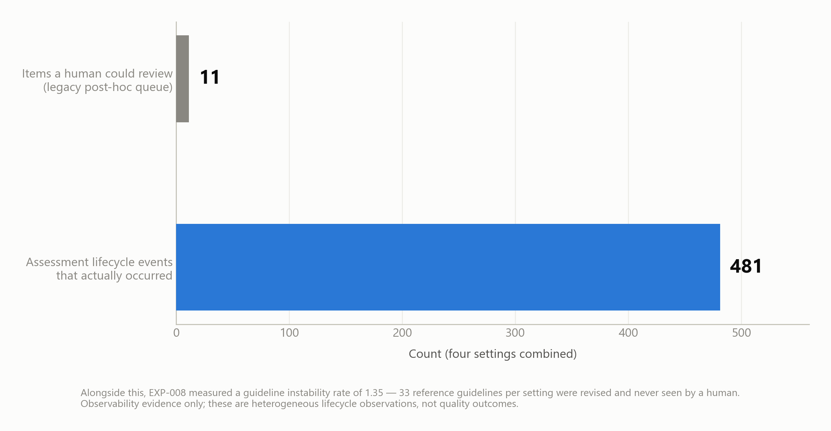
MOTIVATION · EVIDENCE FROM MY OWN INSTRUMENTATION
The same gap is measurable inside the pipeline
Replaying the assessment pipeline as an event stream shows how little of its reasoning was ever reviewable — and that asking more often does not fix it.
44×
more lifecycle events occurred than the legacy review queue could show
33
reference guidelines per setting revised with no human ever seeing them
0.80+
share of events a human must see to reach 80% high-severity coverage
EXP-006/007/008 · mechanism and observability evidence only. These are heterogeneous lifecycle observations and routing trade-offs, not quality outcomes — they support no claim about assessment accuracy.
Notes:
The published evaluation looks at outputs. I instrumented the process.
Four settings produced 481 lifecycle events; the review queue a human actually had could
surface 11. Thirty-three reference guidelines per setting were revised without any human
review - and those guidelines are what every assessment is measured against.
Then the third number, which is the real research problem: to catch 80% of high-severity
events you must route roughly 80% of them to a person. That defeats the automation. So "add
a human in the loop" is not yet an answer - WHICH cases, WHEN, and at what dose is open.
Careful: this says the process was invisible and the trade-off is real. It does NOT say the
assessments were wrong. I have no expert labels yet. (~55 sec)

Slide 5
RESEARCH CONTEXT · THE VEGO-AI BASELINE
Where judgment would enter the pipeline
Four coordinated agents. The review asks what a governed human-judgment layer around them would have to do.
Language Advisor
language template · metamodel semantics
Domain Advisor
reference guidelines · valid alternatives
Model Inspector
case assessment · uncovered fragments
Variability Explorer
recurring patterns · population view
language-rule ambiguity
guideline mapping, scope
disputed compliance
pattern interpretation
Reported as working
Modular separation of language and domain concerns; reasonably stable templates and guidelines in the reported settings.
Not established
No general correctness across institutions, LLMs or domains; no validated reusable human-judgment mechanism; no healthcare readiness.
Notes:
Brief research context, not a product demo. Four agents, each producing something a human
might need to rule on - the red boxes are the insertion points.
Then the honest split at the bottom. What the manuscript reports as working, and what is
simply not established. I am building on their foundation, not claiming their results as
mine - and I am not an author of that paper. (~50 sec)

Slide 6
WHAT I AM ASKING
The research question
How can human judgment be captured, governed, and used to support agentic-AI-driven variability exploration in guideline operationalization scenarios, enabling reliable human–AI co-reasoning?
It names the task, not the solution
The object of study is variability exploration in guideline operationalization — not a particular agent architecture.
It is narrower than “human–AI collaboration”
Intervention and reuse must attach to a real decision unit: a guideline mapping, a fragment classification, a pattern.
Reuse is not assumed in the headline
Whether captured judgment may be reused is a governed, testable concern for the sub-questions — not a premise.
Drafting baseline, not supervisor-approved wording. D-RQ-01/D-RQ-02 remain open, along with “exploration” versus “identification and classification” and “human” versus “expert” judgment.
Notes:
Read the question once, slowly. Then the three decisions behind its wording, because this
course cares about how a question is built.
It names the task not the solution. It is deliberately narrower than "human-AI collaboration"
- it has to attach to a real decision unit. And it keeps reuse OUT of the headline, so reuse
stays something I test rather than assume.
Be honest that the wording is still provisional; two specific words are unresolved. (~45 sec)

Slide 7
DERIVED SET OF QUESTIONS
Three derived questions — which become three studies
Each sub-question owns one stage: when to ask, what to keep and govern, and where a ruling may travel.
SQ1
When to ask
When and how should an agentic assessment system request human judgment, so that important uncertainties are addressed without unnecessary expert burden?
Study 1 · selective intervention
SQ2
What to capture and govern
How should expert judgment — including the system's own reasoning — be represented, validated, reconciled and stored so it can be reused transparently, without unsafe generalization or loss of human authority?
Study 2 · judgment lifecycle
SQ3
When to reuse and transfer
How can expert judgment be reused and transferred across guideline-operationalization contexts — what generalizes, and what must adapt?
Study 3 · transfer and evaluation
Separating the studies prevents one small label set from being treated as evidence for intervention policy, representation validity and transfer at once. The umbrella question is answered only after they integrate.
Notes:
Three sub-questions, and each has to become a study with its own artifact, comparator and
falsification criterion - that is the structure my supervisors asked for, and it maps onto
the design-science framing from this course.
The footnote matters: separating them is a methodological safeguard. Otherwise the same
twenty-odd expert labels get reused as evidence for everything, which would be indefensible.
Say it plainly: the questions are domain-neutral. Software engineering and medicine are where
I would test them, not what they are about. (~55 sec)

Slide 8
METHOD
How the review was done
A structured exploratory review with systematic controls — organised by concepts, not by paper summaries.
Relevant research areas
Human involvement in agentic AI — the core mixed initiative, levels of agency, oversight, control
Selective intervention learning to defer, abstention, uncertainty, value of information, burden
Judgment capture and governance reasoning capture, provenance, disagreement, authority, expiry, revocation
Memory, reuse and transfer scope-aware retrieval, domain and guideline adaptation, leakage-safe evaluation
Deliberately outside the review body: enabling technologies (model architectures, local-inference tooling). They are engineering means — the review must justify the problem, not describe the solution.
Screening
Include methods, frameworks, artifacts, empirical studies.
Exclude duplicates, passing mentions, off-topic enabling tech, unverifiable sources.
GenAI disclosure
Used for organisation, synthesis drafting, diagrams and consistency checks. Not used to approve inclusion, invent citations, or create expert labels.
Notes:
The course asks for the search process to be explicit, so this is the honest version.
Four research areas. The first is the centre of gravity, and that was a deliberate
supervisory decision: organise the review around human involvement in agentic AI generally,
NOT around our specific application. The literature has to justify the problem, not describe
my solution.
Note what I exclude - enabling technology. Interesting, but it belongs in the methodology
chapter, not in the review that establishes the gap.
The GenAI box is a course requirement and I would rather show it than be asked. (~55 sec)

Slide 9
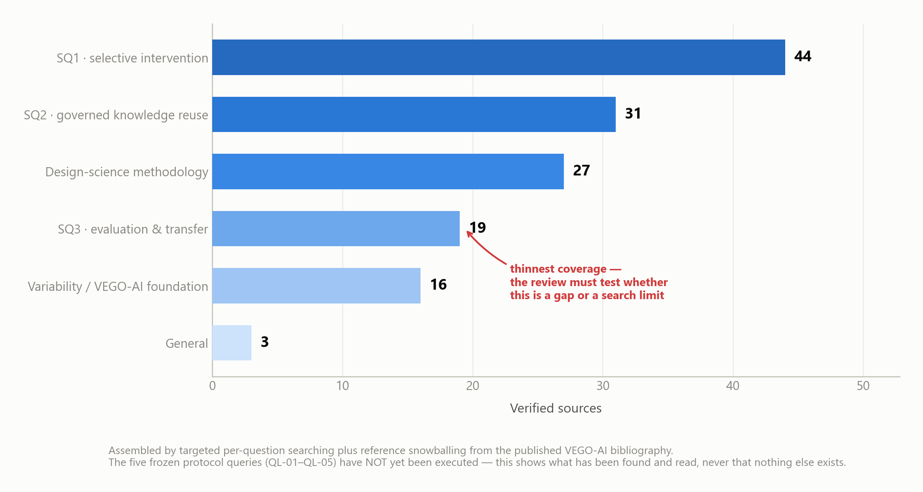
METHOD · SOURCES, QUERIES AND STATUS
Search strategy — and what has actually been executed
The query families are locked. Presenting them is not the same as claiming the formal searches have been run.
Locked query family — SQ1
(learning to defer OR algorithmic triage OR abstention OR selective prediction) AND (human OR expert) AND (cost OR burden OR timing OR uncertainty OR disagreement)
Sources: Scopus · ACM DL · IEEE Xplore · SpringerLink · Web of Science. Scholar and dblp for discovery, snowballing and verification.
Execution status
QL-01–QL-05: 0 of 5 executed
20 RQ-anchor mappings verified (5 per question); evidence maturity 14 full-text + 6 record-level. This is what has been found and read — not evidence that nothing else exists.
Notes:
This is the CL7 search-strategy requirement, answered without pretending.
The query families are locked and registered - I can show you the exact strings. The sources
are named. But the formal database searches have NOT been executed: zero of five.
So what IS the evidence base? Twenty anchor mappings, five per research question, each
bibliographically verified; fourteen at full text, six at record level.
That means I can say what I have read. I cannot say what does not exist. Every gap on the
next slides is stated inside that limit - and I will say so again when I get there. (~50 sec)

Slide 10
FINDINGS · RESEARCH STREAMS
Six streams — each governs part of the lifecycle
Concept matrix from the review: what each stream asks, and what it leaves open for governed judgment in agentic assessment.
1
Learning to defer / reject option SQ1
2
Mixed initiative & human-centred AI SQ1
3
Explanatory debugging & disagreement SQ2
When to route a decision to a human — uncertainty, expert performance, cost, selective risk.
Leaves open usually treats the expert's response as a terminal label.
Who acts and who controls — initiative timing, transparency, correction, override.
Leaves open does not specify a reusable judgment object.
How users correct reasoning, and how multiple human judgments relate — dissent, ambiguity, reconciliation.
Leaves open rarely addresses long-term scope and revocation.
4
Provenance & documentation SQ2
5
Retrieval & external memory SQ3
6
Domain & guideline adaptation SQ3
Where evidence and decisions came from — lineage, attribution, purpose, limitations.
Leaves open does not decide when to ask, or when reuse is permitted.
How prior evidence is retrieved — non-parametric access over versionable sources.
Leaves open similarity alone grants neither authority nor transfer permission.
How knowledge moves across contexts — source–target comparison, local validation, transparency.
Leaves open not tailored to granular human judgments inside agent pipelines.
Concept matrix condensed from structured review v9 §11.1. Each “leaves open” is a residual limitation of the reviewed work — not a claim that the field contains nothing further.
Notes:
Six streams — don't read them out.
Make ONE point: every stream is strong at one checkpoint and silent at another. Deferral knows when to route but treats the answer as a terminal label. Mixed initiative manages control but defines no reusable object. Provenance records lineage but never decides when to ask. Retrieval finds similar cases but similarity is not permission.
That pattern is what forced the framework on the next slide: I needed to see the handovers, not the topics. (~55 sec)

Slide 11
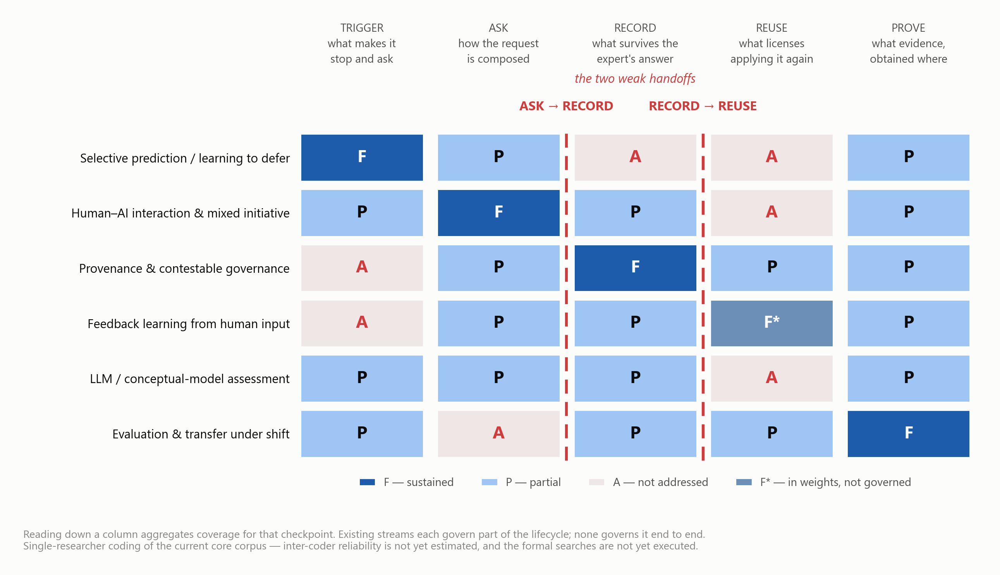
FINDINGS · CLASSIFICATION FRAMEWORK
Judgment-lifecycle coverage across the streams
The unit of analysis is not a paper and not a topic — it is one expert ruling, and the five checkpoints it must pass from the moment an agent hesitates to the moment someone claims the ruling still holds elsewhere.
WHAT THE COLUMNS REVEAL
ASK → RECORD
Streams that are strong at eliciting a judgment are weak at keeping it. The correction is captured, then the reasoning behind it is discarded.
RECORD → REUSE
Streams that are strong at storing are weak at licensing. Retrieval fires on similarity; nothing checks whether this ruling may govern this new case.
No stream spans the loop
Each governs part of the lifecycle. The contribution opportunity is the connection between them, not a missing isolated algorithm.
Coding is single-researcher synthesis over the current core corpus; inter-coder reliability is not yet estimated, and the formal searches are not yet executed. Structured review v9 §11–12.
Notes:
This is the centre of the talk — the classification framework CL7 asks for.
The move that made it work: stop classifying papers by topic, and instead follow ONE expert ruling through five checkpoints — trigger, ask, record, reuse, prove. Each column is a governance question.
Now read DOWN the columns. That is aggregation, and it is where the gaps become visible. The two dashed lines are the finding: ASK→RECORD and RECORD→REUSE are the weak handoffs.
Say the caveat out loud: this is my coding of the corpus I have read, single-researcher, no inter-coder reliability yet. Running the formal searches may change a cell — that would be a real result, not a failure. (~85 sec — most important slide)

Slide 12
FINDINGS · IDENTIFIED GAPS
What the framework makes visible
Each gap is a thin or empty region of the matrix, paired with the artifact hypothesised to close it.
Six residual gaps — each with a matching contribution hypothesis
G1
Bounded-attention intervention
Deferral and active-learning work supplies routing methods, but not a policy combining uncertainty, consequence, disagreement, novelty, reuse value and queue state at fragment and pattern level.
C1 · Selective Human Review Orchestrator
G2
Reasoning-rich judgment representation
Feedback systems capture corrections and annotation systems capture labels; the joint representation of decision trace, rationale, evidence, scope, authority and outcome is not established for agentic modelling assessment.
C2 · Governed Judgment Object
G3
Governance lifecycle
Provenance and contestability are well motivated, but operational rules for validation tiers, conflicts, supersession, expiry, revocation and claim-specific authority are missing.
C3 · Contestable Judgment Store
G4
Scope-aware memory
Retrieval augmentation provides retrieval, but not permission. The missing mechanism combines semantic retrieval with hard governance gates and advisory use.
C4 · Scope-Aware Retrieval Advisor
G5
Transfer and leakage controls
Adaptation research motivates local validation, but the transfer properties of individual expert judgments and the correct frozen-store evaluation design remain open.
C5 + C6 · Transfer Ladder · Leakage-Safe Harness
G6
Construct validity of the variability distinction
“Substantial” versus “occasional” mixes validity with frequency language, and may obscure guideline mismatch, ambiguity and distinct error types.
Terminology / rubric revision
C1–C6 are design and research-contribution hypotheses. They may be called implemented only when the artifact exists and passes tests, and empirically beneficial only after independent evaluation.
Notes:
Six gaps, six matching contribution hypotheses — C1 to C6.
Framing matters enormously here: each gap is a thin or empty region of the grid you just saw. Gaps come from the findings, not from the conclusion — that is the course's rule and it is also just good science.
Avoid the lazy framing that this area is unstudied — deferral and provenance plainly are studied. The defensible gap is the INTEGRATION: connecting intervention, representation, governance, memory and transfer into one traceable loop for variability exploration.
And be explicit: C1–C6 are design and research hypotheses. They are not implemented, and not empirically beneficial, until artifacts pass tests and independent evaluation. (~65 sec)

Slide 13
CONCLUSION · DIRECTION AND HARD GATES
The gap is integration — and here is what would falsify it
The gap is integration, not an isolated missing algorithm.
Mixed initiative already manages initiative; deferral already allocates cases; provenance already encodes lineage; retrieval already surfaces evidence; adaptation already models shift. What is unresolved is how to connect them into one traceable loop: request judgment selectively, capture it at the reasoning level, govern it as a versioned lifecycle object, reuse it only as scope-filtered advice, and evaluate it across a frozen leakage boundary.
1
Finalize RQ terminology
supervisor decision log; D-RQ-01/02
2
Execute the locked searches
QL-01–QL-05, currently 0 of 5
3
Collect independent expert labels
EXP-005 at 0/24; ≥20 targeted
4
Evaluate SQ1 and SQ2 first
burden, traceability, same-domain reuse
5
Then transfer, frozen-store
matched control + blind target labels
6
Medical only after gates
readiness 0/6; Plan B stays software
Human judgment should be requested selectively, captured with its reasoning, governed as a contestable lifecycle object, reused only as scoped advice, and evaluated across a frozen leakage boundary.
Thank you — questions welcome.
Notes:
Pull it together. The gap I take is the connected one - not "when to ask", not "what to
store", but the fact that these are studied separately and the handovers between them are
where the open questions live.
Then the gates, in order, because a research agenda without gates is a wish list. Note that
three of the six are hard blockers I do not control: the wording decision, the labels, and
medical governance.
Close on the design thesis sentence. That is the one sentence I want them to remember.
(~55 sec)

Slide 14
BACKUP · TERMINOLOGY
Exact provisional wording and construct boundaries
Preserved verbatim so the wording can be challenged precisely.
Provisional questions
U-RQ How can human judgment be captured, governed, and used to support agentic-AI-driven variability exploration in guideline operationalization scenarios, enabling reliable human–AI co-reasoning?
SQ1 When and how should an agentic assessment system request human judgment, so that important uncertainties are addressed without unnecessary expert burden?
SQ2 How should expert judgment — including the system's own reasoning — be represented, validated, reconciled and stored so it can be reused transparently, without unsafe generalization or loss of human authority?
SQ3 How can expert judgment be reused and transferred across guideline-operationalization contexts — what generalizes, and what must adapt?
Construct boundaries
Human judgment a context-bound assessment, correction, rationale or policy decision by an authorized person — not a label.
Expert judgment authority tied to domain, language, pedagogical or governance competence; partial and contestable.
Substantial variability a contextually justified alternative consistent with language semantics and domain logic.
Occasional variability an error, misconception or non-compliance — the term does not mean rare, which is a construct-validity problem flagged as G6.
Reusable judgment a governed record retrievable under explicit scope, authority, version and validation conditions.
Notes:
Use if asked for exact wording, or if someone challenges the substantial/occasional
terminology - which is a fair challenge, and it is why G6 exists.

Slide 15
BACKUP · CLAIM DISCIPLINE
Evidence levels and permitted claim language
Every statement in the review is bounded by the maturity of the evidence behind it.
FT-A
Official or author-hosted full text reviewed for method, finding and limitation. Current count: 14.
May support bounded detailed claims with a locator.
FT-B
Substantial authoritative excerpt or repository record reviewed; full article not fully inspected. Current count: 6.
May support only the directly visible claim.
ID-S
Bibliographic identity verified — title, venue, DOI or authoritative record checked.
Discovery and candidate relevance only.
AB-S
Title or abstract screened without sufficient full-text evidence.
Search-space description only — never gap proof.
Synthesis
Reasoning that integrates sources or proposes a mechanism.
Must be labelled synthesis, implication or research hypothesis.
Notes:
This is the slide that answers "how do you know you are not overclaiming". Each claim in the
review is tagged to the maturity of its evidence, and the permitted wording follows from
that tag rather than from how confident I feel.

Slide 16
BACKUP · PROVISIONAL ANSWER
SQ1 — selective intervention is a resource-allocation problem
Uncertainty alone is insufficient. Priority must also weigh consequence, novelty, disagreement, reuse value and burden.
Trigger signals
• Calibrated uncertainty
• Cross-agent disagreement
• Novelty or coverage gap
• Consequence and policy importance
• Weak underlying evidence
• Expected value of information
• Reviewer burden and queue state
Intervention modes
Proceed and log low impact, familiar
Focused review uncertain but bounded
Queue or batch review important, not urgent
Interrupt or stop high consequence
Provisional answer: request judgment when the expected value of expert information exceeds review burden and interruption risk — targeting the smallest decision unit.
Notes:
Use if asked why a confidence threshold is not enough. The point is bounded expert attention:
a policy, not a threshold - and the priority score is a design hypothesis, not an estimated
model.

Slide 17
BACKUP · THE GOVERNED JUDGMENT OBJECT
SQ2 — a reusable judgment is not a naked label
The minimum reusable unit carries its grounding, its reasoning, its authority and its lifecycle.
1
2
3
Case grounding
artifact · fragment · guideline version · evidence locator
Decision trace
system claim · confidence · concise reasoning · correction
Governance
authority · scope · visibility · dissent · permission
4
5
6
Lifecycle
validated · expired · superseded · revoked · active
Reuse signals
semantic signature · counterexamples · thresholds
Outcome trace
retrieval · influence · override · downstream effect
Reasoning-capture rule
Store the shortest sufficient decision trace — claim, evidence, rule, uncertainty and correction. Not hidden chain-of-thought, and not unnecessary personal data.
Notes:
Use if asked what "capturing judgment" actually means. The acceptance test is
reconstruction: could an authorized reviewer who was not present rebuild why this ruling was
made? The reasoning-capture rule at the bottom is the privacy and proportionality boundary.

Slide 18
BACKUP · TRANSFER LADDER AND LEAKAGE CONTROLS
SQ3 — retrieval is not permission
Reuse is advisory and scope-filtered; evidence requirements rise with transfer distance.
L0
same-case retry
default relevance high
Leakage-safe evaluation
• Frozen source store and retrieval policy
• Matched no-reuse control
• Independent blind target labels, set before source judgments
• Store updated only after scoring
• Predeclared thresholds
L1
same task and domain
advisory after scope checks
L2
new task, same domain
independent labels + holdout
L3
adjacent domain
preregistered restricted experiment
L4
cross-domain / healthcare
no default permission; ethics + authorization
Notes:
Use for the transfer question. The one line to land: similarity retrieves, permission
governs. And updating the store from target labels before evaluation would break the
frozen-store design and void any transfer evidence - which is why it matters.

Slide 19
BACKUP · RESEARCH CONTRACT
Three studies, each independently falsifiable
Separate units of analysis prevent one small label set from carrying every claim.
Study 1 / SQ1
Selective Human Review Orchestrator
Held-out cases, policy baselines, burden logging
Falsified by: no gain over a simpler baseline, or unacceptable burden
Study 2 / SQ2
Governed Judgment Object + Contestable Store
Label-only comparator, reconstruction and lifecycle tests
Falsified by: reviewers cannot use the object, or governance cost outweighs benefit
Study 3 / SQ3
Scope-Aware Retrieval Advisor + transfer classifier
Frozen store, blind labels, matched no-reuse control
Falsified by: no target benefit, or effect vanishes under blinding
Integrated / U-RQ
End-to-end governed lifecycle
Human-only, AI-only and non-governed baselines
Falsified by: any load-bearing study fails, or gain is only extra human effort
Notes:
Use if asked "how would you know you are wrong". Every study has a stated falsification
condition, written before the data exists. Note also that EXP-005 alone cannot satisfy all
three - each has its own estimand.

Slide 20
BACKUP · METHOD AND HONESTY CONTROLS
Design science, GenAI use, and the evidence boundary
How this sits in the course's design-science frame, and exactly what is not being claimed.
Design science
Relevance expert review is scarce; deviation meaning is contextual; guidelines drift unseen
Design selective-intervention policy + governed judgment lifecycle, built and evaluated per sub-question
Rigor structured review with evidence levels; the lifecycle framework is itself a candidate contribution back
GenAI — used for
• Literature organisation
• Synthesis drafting
• Diagram production
• Consistency checks
• Document layout
Not used for
• Approving inclusion decisions
• Inventing citations
• Creating expert labels
• Claiming supervisor approval
Not claimed
• No improvement in assessment accuracy — expert labels stand at 0 of 24.
• No reduction in expert workload.
• No safe generalization or transfer.
• Nothing about clinical performance — medical readiness 0 of 6.
• No claim that the literature holds no prior solution — the formal searches are not yet executed.
Notes:
The slide I would use if someone asks "so does it work?" or "how much of this did AI write?".
Honest answer to the first: I can show mechanism and observability and the trade-off. I
cannot show quality, effort or transfer, because that needs independent expert labels and I
have none validated.
Honest answer to the second: AI helped organise, draft and draw. It did not decide what to
include, invent a citation, or create a label. Stating that boundary is what makes the rest
credible.

